Slide 1
Big Mountain Resort

Slide 2
Problem Identification
BMR recently added a new chair lift expected to cost an additional $1,540,000 this coming season.
BMR needs to adjust ticket prices to account for this change.
We can use statistics on BMR and its competitors to set a data driven ticket price.
We can make predictions about which changes will allow us to demand a higher ticket price going forward.

Slide 3
Key Findings and Recommendation
BMR should be charging between $5 to $25 more than it is currently.
Adding a run, increasing vertical drop by 150 feet, and adding a new chair lift is likely to be very profitable.
Run closures have a very limited effect on ticket price.

Slide 4
Modeling and Analysis:
Ticket Price
We trained a machine learning model on data of competitors.
We can use this model to predict an appropriate ticket price based on various statistics about BMR or another hypothetical resort.
The model predicts a price of $95.87.
The model has a MAE of $10.39.

Slide 5
Modeling and Analysis:
New Run and Lift
We used our model to evaluate several hypothetical facility changes.
Our model predicts that adding a run, increasing vertical drop by 150 feet, and adding a new chair lift will bring in $3474638 gross over the season.
Assuming this chair lift has a cost similar to the one just installed, this is about $1.9 million profit over the first season.

Slide 6
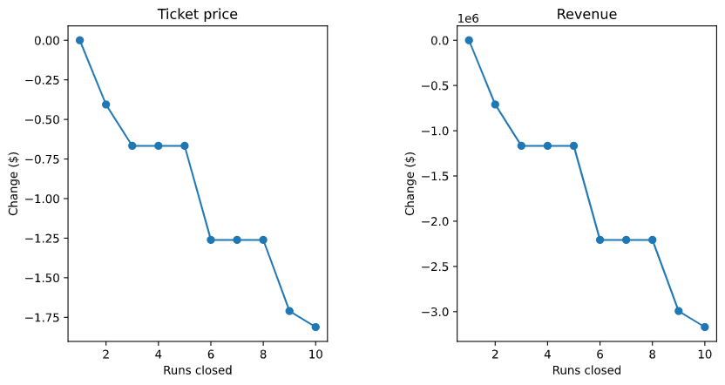
Modeling and Analysis:
Run Closures
5 or fewer run closures is predictive of less than $1 decrease of ticket price.
No need to adjust ticket prices if we close some some runs after ticket prices have been set for the season

Slide 7
Conclusion
Increase ticket price by $5 to $25.
Look further into adding a new run and chair lift.

